Slide 1
Moto
In Our software development life every day we do some code but very few of us get chance to develop full fledged application and most of the time we get design from our main development center. And under pressure of delivery we do development without the understanding of design.
These training sessions are our small efforts to share knowledge of software designing to our brothers and sisters.

Slide 2
Scope
Recap of OOP (Object Oriented Programming)
SOLID Principles
Design Patterns
On Fly Notification System
Dependency Injection
Castle Windsor (Container for DI)
Plug in based architecture
Framework designing

Slide 3
What is OOP?
Every thing in world is object which has attributes and action for their identification.
Other important aspect is relationship among objects.
When we use these objects and their relationship to make a software called object oriented programming.

Slide 4
Four pillars of OOP?
Essential information required to identify any object with out its detail. Information can be attribute or action or both.
Or
The process of formulating general concepts by abstracting common properties of instances.
Abstraction
Encapsulation
Inheritance
Polymorphism
Encapsulation is mechanism to achieve abstraction
Any attribute or immaterial possession that is inherited from ancestors
Polymorphism (from the Greek meaning "having multiple forms") is the characteristic of being able to assign a different meaning or usage to something in different contexts

Slide 5
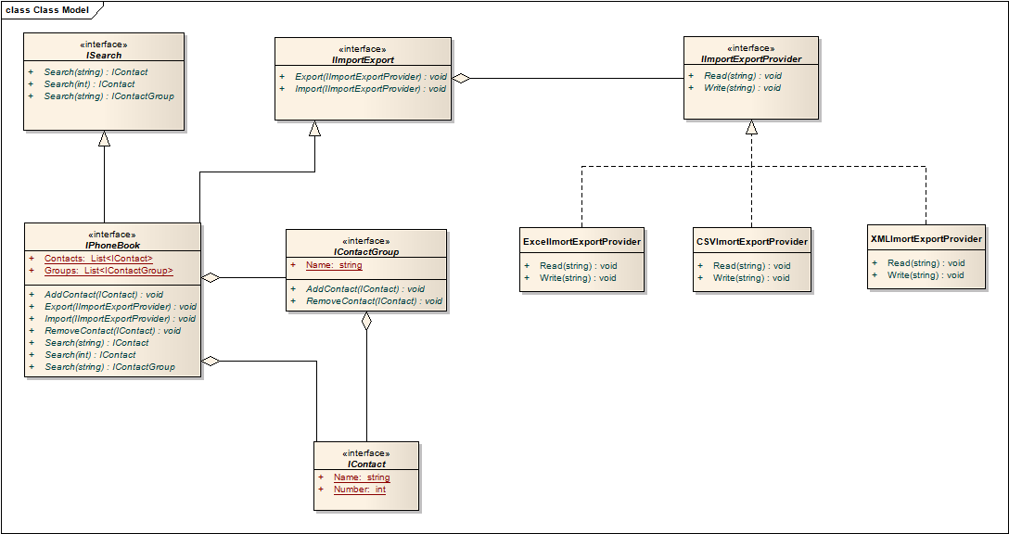
Design a phonebook
Phone book has contacts information.
Each contact has name and numbers as primary fields and other fields as secondary (Optional) like email address etc.
We can search contact by providing name or number.
When we create phone book there should be at-least one contact information in phonebook.
We can add and remove contacts from phonebook
We can make a group of contacts.
If we search any group in phonebook should get all contacts of that group.
We can add and remove contacts from group.
We can import and export contacts in CSV, xml and Excel file.

Slide 6
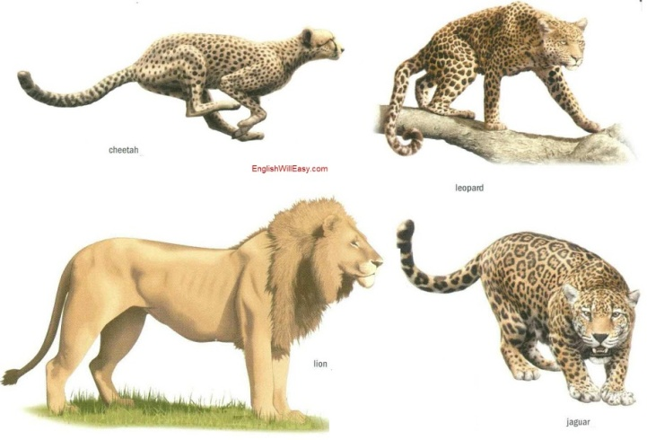
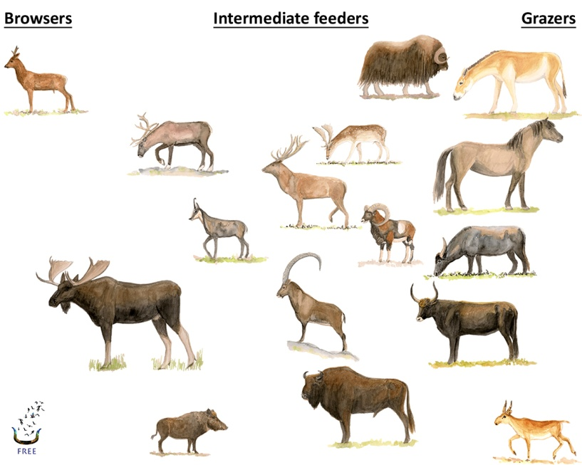
Animals
Animals
Herbivores
Carnivores
Abstraction

Slide 7
public interface IAnimal
{
}
public interface IHuman : IAnimal
{
string Age { get; set; }
string Gender { get; set; }
}
IAnimal
IHuman
Is A
Where we use it let see this in sample code

Slide 8
Generalization Vs Specialization
Shape
Square
Circle
Triangle
Specialization
Generalization

Slide 9
Generalization Vs Specialization
IShape
Square
Circle
Triangle
Specialization
Generalization
Realization

Slide 10
Aggregation(Has a relationship)
public class Student
{
public string Name { get; set; }
public string Class { get; set; }
}
public class School
{
public List<Student> Students { get; private set; }
public School(List<Student> students)
{
this.Students = students;
}
}
Aggregation is a special case of association. A directional association between objects. When an object ‘has-a’ another object, then you have got an aggregation between them. Direction between them specified which object contains the other object. Aggregation is also called a “Has-a” relationship.

Slide 11
Composition (Has a relationship)
public class Student
{
public string Name { get; set; }
public string Class { get; set; }
}
public class School
{
public List<Student> Students { get; private set; }
public School()
{
this.Students = new List<Student>();
}
}
Composition is a special case of aggregation. In a more specific manner, a restricted aggregation is called composition. When an object contains the other object, if the contained object cannot exist without the existence of container object, then it is called composition.

Slide 12
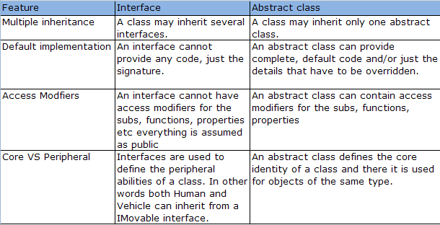
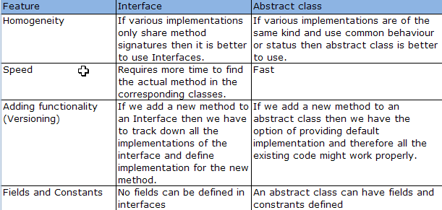
When to use interface and when to use abstract class?

Slide 13
Signs of Bad Design
Rigidity
Code difficult to change (Continuity)
Management reluctance to change anything becomes policy
Fragility
Even small changes can cause cascading effects
Code breaks in unexpected places (Protection)
Immobil-ity
Code is so tangled that it's impossible to reuse anything
Composability
Viscosity
Much easier to hack than to preserve original design

Slide 14
Design Principle
Single Responsibility
Open-Closed
Liskov Substitution
Interface Segregation
Dependency Inversion

Slide 15
Single Responsibility
Changing code in a tested class can introduce new bugs. We seek to minimize the reasons why a class might need to change. The more different things a class does, the more reasons it might have to change.

Slide 16
Open-Closed Principle (OCP)
"Software Systems change during their life time"
both better designs and poor designs have to face the changes;
good designs are stable
Software entities should be open for extension,
but closed for modification
B. Meyer, 1988 / quoted by R. Martin, 1996
Be open for extension
module's behavior can be extended
Be closed for modification
source code for the module must not be changes
Modules should be written so they can be extended
without requiring them to be modified

Slide 17
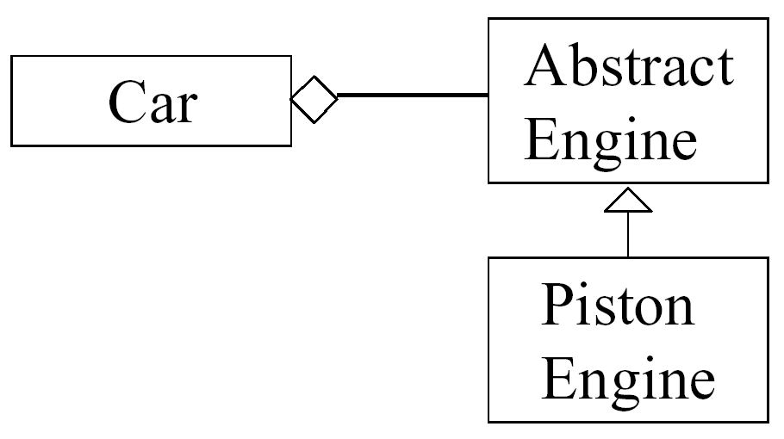
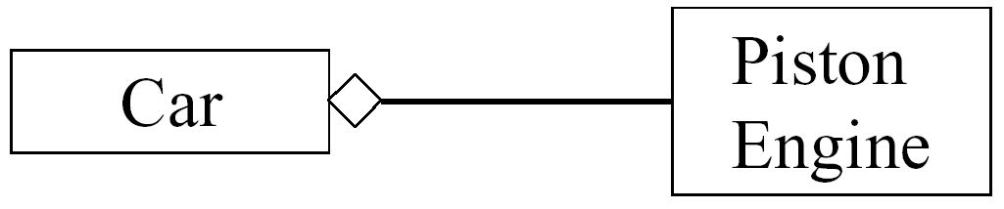
Is below design Closed for modification?
No,
What happen when new engine type come
Yes,
Now car is containing abstract engine, so by using polymorphism car can be used provided concrete engine

Slide 18
Liskov Substitution Principle (LSP)
The key of OCP: Abstraction and Polymorphism
Implemented by inheritance
How do we measure the quality of inheritance?
Lets understand this principal by sample code
Inheritance should ensure that any property proved about super type objects also holds for subtype objects
B. Liskov, 1987
Functions that use pointers or references to base classes
must be able to use objects of derived classes
without knowing it.
R. Martin, 1996

Slide 19
Interface Segregation
If different clients depend on different methods of the same class, then a change to one method might require a recompile and redeployment of other clients who use different methods. Creating several client-specific interfaces, one for each type of client, with the methods that type of client requires, reduces this problem significantly.

Slide 20
Dependency Inversion Principle
I. High-level modules should not depend on low-level modules.
Both should depend on abstractions.
II. Abstractions should not depend on details.
Details should depend on abstractions
R. Martin, 1996
OCP states the goal; DIP states the mechanism
A base class in an inheritance hierarchy should not know any of its subclasses
Modules with detailed implementations are not depended upon, but depend themselves upon abstractions

Slide 21

Common design patterns
Creational Patterns
Factory Method
Abstract Factory
Builder
Singleton
Structural Patterns
Adapter
Behavioral Patterns
Observer
Iterator
Others
MVP
DI

Slide 22
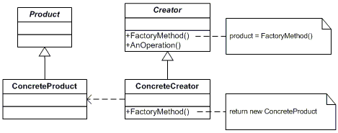
Factory pattern
Define an interface for creating an object, but let subclasses decide which class to instantiate. Factory Method lets a class defer instantiation to subclasses.
Lets understand this by sample code

Slide 23
Code (factory Pattern)

Slide 24
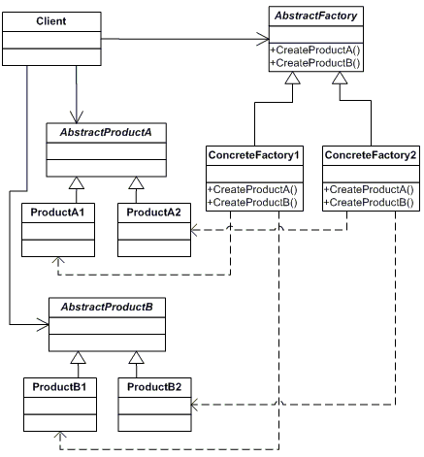
Abstract Factory
Provide an interface for creating families of related or dependent Objects without specifying their concrete classes.
Lets understand this by sample code

Slide 25
Code(Abstract factory)

